Slide 1
Data Structures Workshop
Day 26

Slide 2
Workshop Outline
Graphs Introduction
Undirected Vs. Directed Graphs
Graph Implementations (Adjacency List & Adjacency Matrix)
Breadth-First Search
Depth-First Search

Slide 3
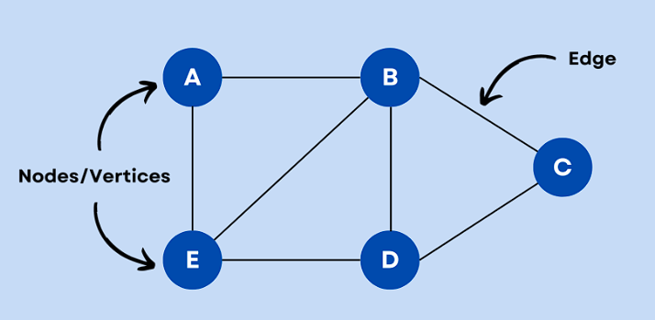
Graphs
A graph is a data structure that represents connections among items and consists of vertices (nodes) connected by edges.
Graph Terminology
Vertex (Node) - item in graph
Edge - connection between two vertices in a graph
Path - sequence of edges leading from a source vertex to a destination vertex
Length - number of edges in a path

Slide 4
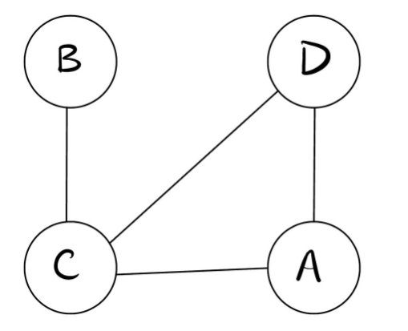
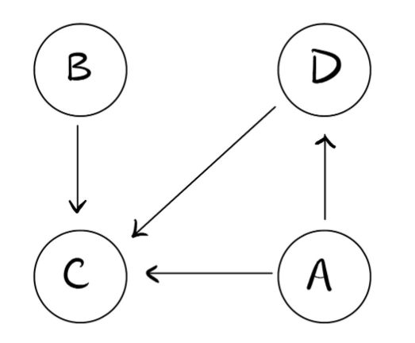
Undirected vs Directed Graphs
Indirect graphs have edges in which traversal can go both ways, to and from a node​ (bidirectional)
Direct graphs edges that point in a certain direction, which indicates that you can only go one way between nodes​

Slide 5
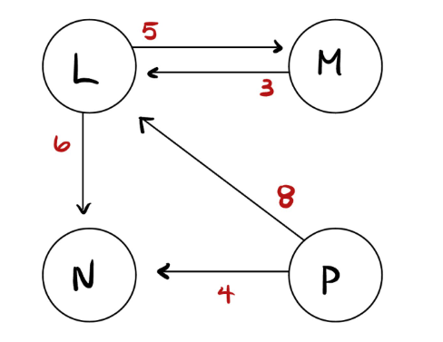
Weighted Graphs
A weighted graph associates a weight with each edge.
Weight - represents some numerical value between vertices (like length, or cost)
Example Problems:
What’s the cost to go from Vertex L to N?
What’s the cost to go from Vertex P to L?
What’s the cost to go from Vertex P to M?

Slide 6
How Are Graphs Represented?
Graphs are commonly represented in 2 ways:
Adjacency Lists
Adjacency Matrices

Slide 7
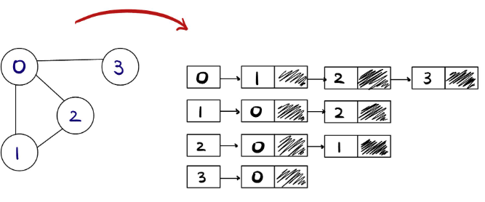
Adjacency List
An adjacency list represents a graph as an array of linked lists.
The index on the array represents a vertex in the graph and each element in its linked list represents other vertices that form an edge with said vertex.

Slide 8
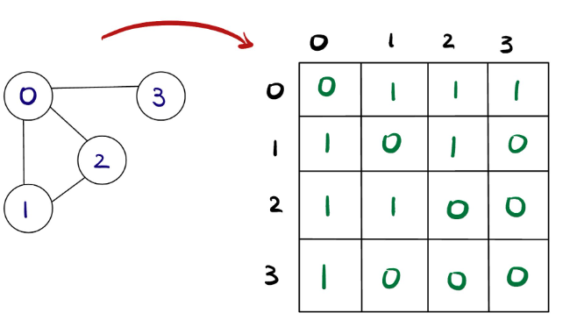
Adjacency Matrix
An adjacency matrix is a way to represent a graph as a matrix of Boolean values (0’s and 1’).
→ ‘0’ - There is NOT an edge between vertex i and j
→ ‘1’ - There IS an edge between vertex i and j
Typically the rows represent the vertices of a graph and the columns represent the edges of a graph.
In the case of undirected graphs, like the one shown, the matrix is symmetrical about the diagonal because for every edge (i, j), there is also edge (j, i).
If not symmetrical along diagonal, it is a directed graph.

Slide 9
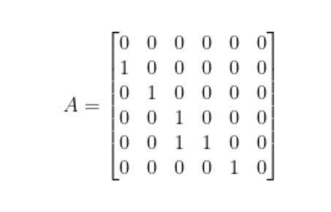
Practice Building a Graph​ (Adjacency Matrix)
Build a directed graph from this adjacency matrix​

Slide 10
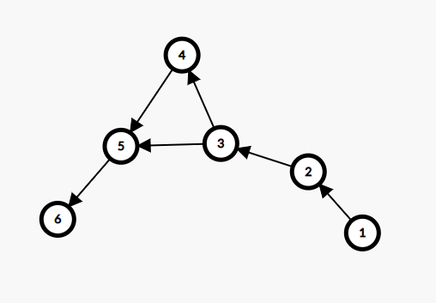
Solution

Slide 11
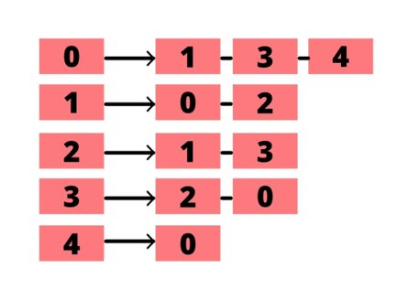
Practice Building a Graph​ (Adjacency List)
Build a graph from this adjacency list

Slide 12
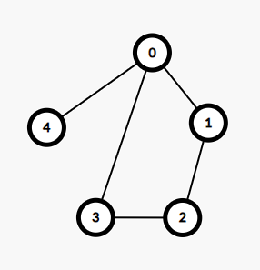
Solution

Slide 13
Traversing Graphs​

Slide 14
Graph Traversal
Given any graph and any node to start, how would you traverse and search for an expected node?
There is no source or root of a graph so you can start anywhere. You don’t want to waste time by revisiting a node as well.
When traversing graphs, you backtrack in order to reach every node possible, but you still need to keep track of nodes you've already visited!
For these graph traversals, we can use either the DFS (Depth-First-Search) or BFS (Breadth-First-Search) algorithms

Slide 15
DFS Algorithms
A graph traversal that visits a starting vertex, then visits every vertex along each path starting from that vertex to the path’s end before backtracking.
What we want to do is mark each vertex as we visit them and try to avoid cycles (so if already visited or being visited, we don’t need to traverse to it again).

Slide 16
DFS Explained
The DFS algorithm uses a STACK and works in the following way:
1. Start by pushing a source vertex to the top of the stack.
2. Take the top item in the stack and add to visited list.
3. Make a list on that vertices adjacent nodes (unvisited). Add the nodes that aren’t in the visited list to the top of the stack.
4. Keep repeating steps 2 and 3 until stack is empty.

Slide 17
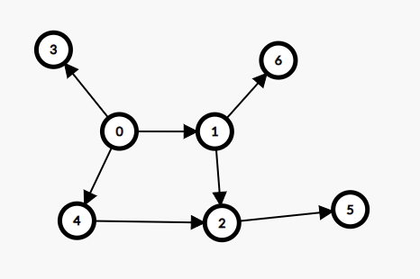
DFS Trace Example
Given the following graph, perform the DFS algorithm and output the order in which the nodes are visited. Assume the source node is ‘0’.

Slide 18
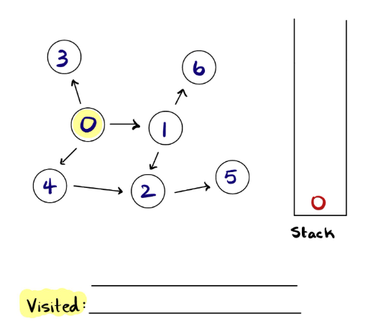

Slide 19
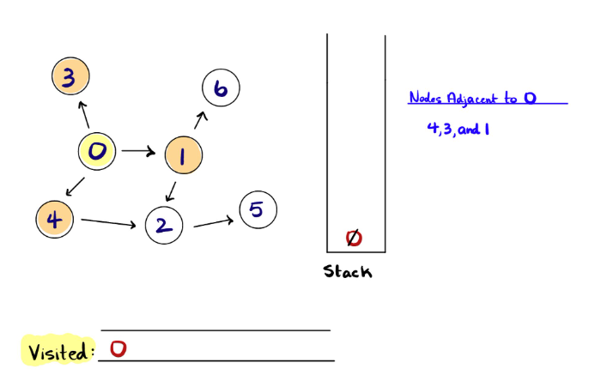

Slide 20
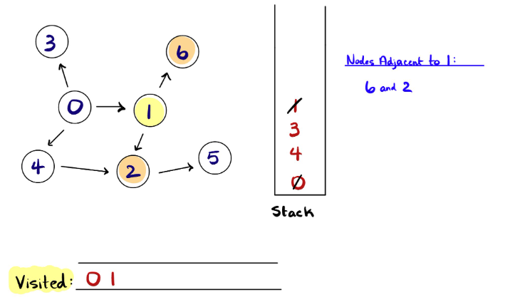

Slide 21
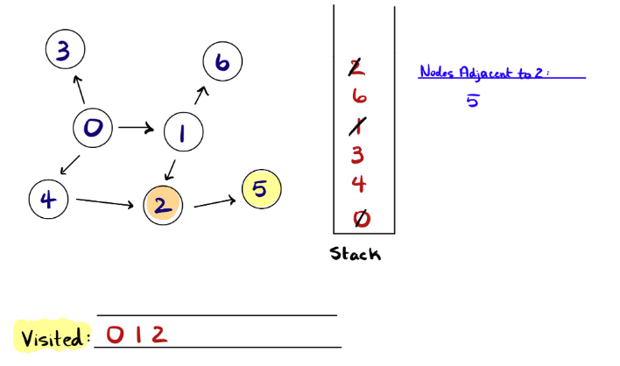

Slide 22
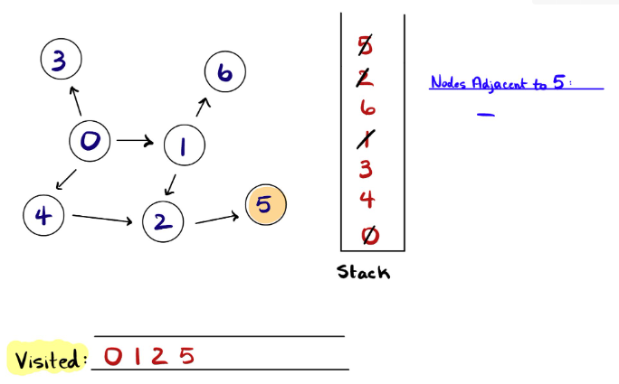

Slide 23
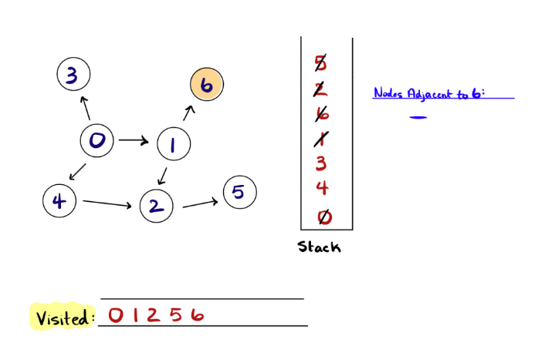

Slide 24
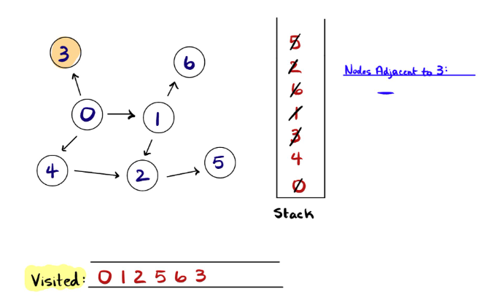

Slide 25
